Slide 1
Database Management Systems (PCCO3040T)
Teaching Scheme | Examination Scheme
Lectures : 03 Hrs./week | Term Test : 15 Marks
Credits : 03 | Teacher Assessment : 20 Marks
 | End Sem Exam : 65 Marks
 | Total Marks : 100 Marks

Slide 2
Course Objectives:
1. To learn and practice data modelling using the entity-relationship and develop database designs.
2. To understand the use of Structured Query Language (SQL) and learn SQL syntax.
3. To apply normalization techniques to normalize the database.
4. To understand the needs of database processing and learn techniques for controlling the consequences of concurrent data access.
5. To introduce principles and foundations of distributed databases, design issues, query processing and optimization.

Slide 4
Course Contents
Unit-I Introduction to Database Concepts 03 Hrs.
Introduction, Characteristics of Databases, File System v/s Database System, Users of Database System, Data Independence, DBMS System Architecture, Database Administrator.
Unit-II Entity–Relationship Data Model 08 Hrs.
The Entity-Relationship (ER) Model: Entity Types: Weak and Strong Entity Sets, Entity Sets, Types of Attributes, Keys, Relationship Constraints: Cardinality and Participation.
Extended Entity-Relationship (EER) Model: Generalization, Specialization and Aggregation.
Unit-III Relational Model and Relational Algebra 08 Hrs.
Introduction to the Relational Model, Relational Schema and Concept of Keys, Mapping the ER and EER Model to the Relational Model.
Relational Algebra: Unary and Set Operations, Relational Algebra Queries.

Slide 5
Unit-IV Structured Query Language (SQL) 09 Hrs.
Overview of SQL, Data Definition Commands, Data Manipulation Commands, Data Control Commands, Transaction Control Commands.
Integrity Constraints: Key Constraints, Domain Constraints, Referential Integrity, Check Constraints, Set and String Operations, Aggregate Function, Group By Clause, Having Clause.
Views in SQL, Joins, Nested and Complex Queries. Introduction to PL/SQL
Unit-V Relational Database Design 10 Hrs.
Pitfalls in Relational-Database Designs, Concept of Normalization, Functional Dependencies, First Normal Form, 2NF, 3NF, BCNF. Transactions Management and Concurrency: Transaction Concept, Transaction States, ACID Properties, Concurrent Executions, Serializability – Conflict and View, Concurrency Control: Lock-Based, Timestamp-Based Protocols.
Recovery System: Introduction to Recovery System.
Unit-VI Distributed Database 04 Hrs.
Introduction to Distributed Database, Features of DDBS, Design Issues in DDBS, Distributed Database Design Concept, Objectives, Data Fragmentation, Transparencies in Distributed Database Design.

Slide 6
Text Books:
1. Korth, Silberchatz, Sudarshan, Database System Concepts, 6th Edition, McGraw – Hill.
2. Elmasri and Navathe, Fundamentals of Database Systems, 5th Edition, Pearson Education.
3. Peter Rob and Carlos Coronel, Database Systems Design, Implementation and Management, 5th Edition, Thomson Learning.
4. Chhanda Ray, Distributed Database System, Pearson Education India.
5. G. K. Gupta, Database Management Systems, McGraw – Hill.
Reference Books:
1. Dr. P.S. Deshpande, SQL and PL/SQL for Oracle 10g, Black Book, Dreamtech Press.
2. Gillenson, Paulraj Ponniah, Introduction to Database Management, Wiley Publication.
3. Sharaman Shah, Oracle for Professional, SPD.
4. Raghu Ramkrishnan and Johannes Gehrke, Database Management Systems, 3rd Edition, McGraw – Hill.
5. M. Tamer Ozsu, Patrick Valduriez, Principles of Distributed Database, 2nd Edition, Pearson Education India.

Slide 7
Data- Raw, Unprocessed facts
Example- 24, Charushri, Banglore, audio, video
Information- Processed data (to make a meaningful context)
Example- age of Charushri is 6.
Database- Collection of Related data.
Random data can not be a Database.
Ex:- Online Banking System, Library Management System
Metadata- Database Definition (complete description of database)

Slide 8
Database Management System (DBMS)
Definition: Collection of programs that enables users to create and maintain the database.
We will call the database and DBMS software together a database system.
A database-management system (DBMS) is a collection of interrelated data and a set of programs to access those data.
The collection of data, usually referred to as the database, contains information relevant to an enterprise.
The primary goal of a DBMS is to provide a way to store and retrieve database information that is both convenient and efficient

Slide 9
Functionalities:
Define: Specifying the Data Type, Structures and Constraints (limits on the data) for the data to be stored.
Construct: Process of storing data on some storage medium. (when data is stored, a database is constructed)
3. Manipulate: Querying the database to retrieve specific data, updating database and generating reports.
4. Share: allows multiple users and programs to access the database concurrently. (many users can access the D/B in an efficient manner)
5. Protection of the Database from the unauthorized access or from hardware, software failures
6. Maintenance of database for a long period of time

Slide 10
Properties of Database
A database represents some aspects of the real world (miniworld).
(object, properties, their relations can be represented by a D/B)
2. A database is logically coherent collection of data with some inherent meaning.
A database is designed, built and populated with data for a specific purpose.
A database can be of any size and of varying complexity.
Ex: The list of names and addresses referred to earlier may consist of only a few hundred records, each with a simple structure.
Ex: The card catalog of a large library may contain half a million cards stored under different categories—by primary author’s last name, by subject, by book title—with each category organized in alphabetic order.

Slide 11
Database-System Applications
Databases are widely used. Here are some representative applications:
• Enterprise Information
◦ Sales: For customer, product, and purchase information.
◦ Accounting: For payments, receipts, account balances, assets and other accounting information.
◦ Human resources: For information about employees, salaries, payroll taxes, and benefits, and for generation of paychecks.
◦ Manufacturing: For management of the supply chain and for tracking production of items in factories, inventories of items in warehouses and stores, and orders for items.
◦ Online retailers: For sales data noted above plus online order tracking, generation of recommendation lists, and maintenance of online product evaluations.

Slide 12
• Banking and Finance
◦ Banking: For customer information, accounts, loans, and banking transactions.
◦ Credit card transactions: For purchases on credit cards and generation of monthly statements.
◦ Finance: For storing information about holdings, sales, and purchases of financial instruments such as stocks and bonds; also, for storing real-time market data to enable online trading by customers and automated trading by the firm.
• Universities: For student information, course registrations, and grades (in addition to standard enterprise information such as human resources and accounting).

Slide 13
• Airlines: For reservations and schedule information. Airlines were among the first to use databases in a geographically distributed manner.
• Telecommunication: For keeping records of calls made, generating monthly bills, maintaining balances on prepaid calling cards, and storing information about the communication networks.
For example: The college Database organizes the data about the admin, staff, students and faculty etc. Using the database, you can easily retrieve, insert, and delete the information.

Slide 14
DBMS contains information about a particular enterprise
Collection of interrelated data Set of programs to access the data
An environment that is both convenient and efficient to use
Database Applications:
Banking: transactions Airlines: reservations, schedules
Universities: registration, grades Sales: customers, products, purchases
Online retailers: order tracking, customized recommendations
Manufacturing: production, inventory, orders, supply chain
Human resources: employee records, salaries, tax deductions
Databases can be very large.
Databases touch all aspects of our lives

Slide 15
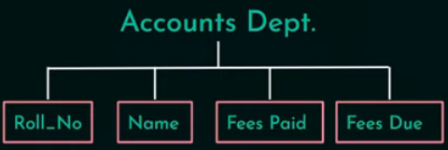
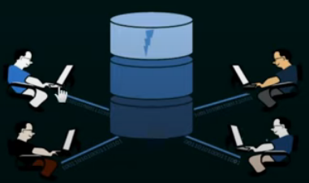
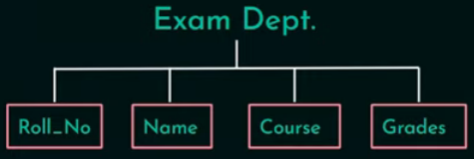
File System Approach
DBMS Approach

Slide 16
Characteristics of DBMS Approach
Self-Describing Nature of a Database System
Database System Database + Metadata (Data Definition)
Stored in: DBMS Catalog (which contains information such as the structure of each file, the type and storage format of each data item, and various constraints on the data. )
Used by: DBMS Software and Database Users
DBMS Software must work equally well with any number of Database Applications.
In traditional file processing, data definition Part of application programs
Work with only one specific DB

Slide 17
Database system contains the database itself and a complete definition or description of the database structure and constraints.
This definition is stored in the system catalog, which contains information such as the structure of each file, the type and storage format of each data item, and various constraints on the data. The information stored in the catalog is called meta-data. (describes the structure of the primary database )

Slide 18
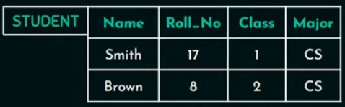

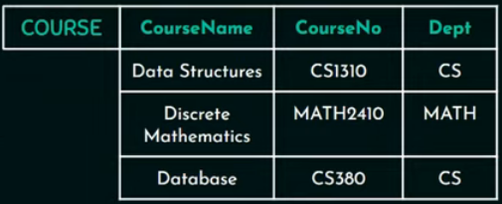
A Database that stores student and Course information

Slide 19
Characteristics of DBMS Approach
2. Isolation between Programs and Data, and Data Abstraction
In Traditional File processing structure of data files is embedded in the application programs. (any changes to the structure of a file may require changing all programs that access this file. )
In database approach structure of data files is stored in the DBMS catalog
separate from access programs (program- data independence)

Slide 20
2. Isolation between Programs and Data, and Data Abstraction
The characteristic that allows program- data independence is called data abstraction.
DBMS provides users with conceptual representation of data.
Data model type of data abstraction provides conceptual representation

Slide 21
The characteristic that allows program-data independence and program-operation independence is called data abstraction.
A DBMS provides users with a conceptual representation of data that does not include many of the details of how the data is stored or how the operations are implemented.
Informally, a data model is a type of data abstraction that is used to provide this conceptual representation.
The data model uses logical concepts, such as objects, their properties, and their interrelationships, that may be easier for most users to understand than computer storage concepts. Hence, the data model hides storage and implementation details that are not of interest to most database users.

Slide 22
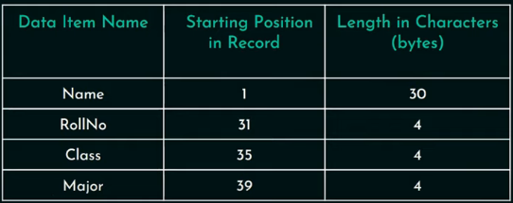
Internal Storage format of a Student Report

Slide 23
3. Support for Multiple Views of the Data
A database has many users, each of whom may require a different view of database
A View subset of database contains virtual data derived from database

Slide 24
4. Sharing of knowledge and Multi-user Transaction Processing
A multiuser DBMS allows multiple users to access the database at the same time.
OLTP (Online Transaction Processing)- major part of database application
For example, when several reservation clerks try to assign a seat on an airline flight, the DBMS should ensure that each seat can be accessed by only one clerk at a time for assignment to a passenger. These types of applications are generally called on-line transaction processing (OLTP) applications.

Slide 25
4. Sharing of knowledge and Multi-user Transaction Processing
DBMS must include concurrency control.
DBMS must enforce several transaction properties:
Isolation: 1 agent assigned a seat to passenger, then that seat is blocked and isolated from other agents.
Atomicity: DBMS ensures whether transaction is executed completely or none at all. If an agent has assigned a seat to passenger and transaction is struck midway or incomplete then that seat should be released for other agent for access.

Slide 26
Users of the Database System
Actors on the Scene
( people whose jobs involve the day-to-day use of a large database )
Database Administrators
Database Designers
End Users- Casual end users, Naive or parametric end users, Sophisticated End Users
System Analysts and Application Programmers (Software Engineers)

Slide 27
Users of the Database System
Workers Behind the Scene
- People whose job is to maintain database system environment.
- they are not interested in the database itself
System Designers & Implementers
Tool Developers
Operators & Maintenance Personnel

Slide 28
Users of the Database System
Actors on the Scene
( people whose jobs involve the day-to-day use of a large database )
{Using large DB everyday)
Database Administrators
Database Designers
End Users- Casual end users, Naive or parametric end users, Sophisticated End Users
System Analysts and Application Programmers (Software Engineers)

Slide 29
Users of the Database System / Actors on the Scene
Database Administrators
In Database Environment, Primary Resource: database
Secondary resource: DBMS & related software
DBA responsibilities:
Administering/ manage: primary / secondary resources
Authorizing: grant access to the database
Co-ordinating & monitoring use of database
Acquiring hardware & software resources as needed
Security issues
Troubleshooting

Slide 30
Users of the Database System / Actors on the Scene
Database Administrators
In any organization where many persons use the same resources, there is a need for a chief administrator to oversee and manage these resources.
In a database environment, the primary resource is the database itself and the secondary resource is the DBMS and related software. Administering these resources is the responsibility of the database administrator (DBA).
The DBA is responsible for authorizing access to the database, for coordinating and monitoring its use, and for acquiring software and hardware resources as needed.
The DBA is accountable for problems such as breach of security or poor system response time. In large organizations, the DBA is assisted by a staff that helps carry out these functions.

Slide 31
Users of the Database System / Actors on the Scene
2. Database Designers
Responsible for-
Identifying the data to be stored in Database
Choosing appropriate structures to represent and store data
Communicating with database users – understand their requirements– Designs Database
Interact with each group of users and develop views for each of group users based on requirement

Slide 32
Users of the Database System / Actors on the Scene
2. Database designers
Database designers are responsible for identifying the data to be stored in the database and for choosing appropriate structures to represent and store this data. These tasks are mostly undertaken before the database is actually implemented and populated with data. It is the responsibility of database designers to communicate with all prospective database users, in order to understand their requirements, and to come up with a design that meets these requirements. In many cases, the designers are on the staff of the DBA and may be assigned other staff responsibilities after the database design is completed. Database designers typically interact with each potential group of users and develop a view of the database that meets the data and processing requirements of this group. These views are then analyzed and integrated with the views of other user groups. The final database design must be capable of supporting the requirements of all user groups.

Slide 33
Users of the Database System / Actors on the Scene
3. End Users
people whose jobs require access to the database for querying, updating, and generating reports
the database primarily exists for their use.
A) Casual end users
occasionally access the database, but they may need different information each time.
They use a sophisticated database query language to specify their requests
are typically middle- or high-level managers or other occasional browsers.

Slide 34
Users of the Database System / Actors on the Scene
3. End Users
B) Naive or parametric end users
make up a sizable portion of database end users.
Their main job function revolves around constantly querying and updating the database, using standard types of queries and updates—called canned transactions—that have been carefully programmed and tested. The tasks that such users perform are varied:
Example: Reservation agents

Slide 35
Users of the Database System / Actors on the Scene
3. End Users
C) Sophisticated end users / Experts
- Engineers, Scientists, Business Analysts
- familiar with DBMS system and facilities
- they develop their own DB application to meet their requirements
D) Stand-alone users
- Maintains personal databases
- Using ready-made program packages (menu driven, graphic based)
- Ex: person with business maintain personal financial data for tax purposes

Slide 36
Users of the Database System / Actors on the Scene
3. End Users
End users are the people whose jobs require access to the database for querying, updating, and generating reports; the database primarily exists for their use. There are several categories of end users:
Casual end users occasionally access the database, but they may need different information each time. They use a sophisticated database query language to specify their requests and are typically middle- or high-level managers or other occasional browsers.
Naive or parametric end users make up a sizable portion of database end users. Their main job function revolves around constantly querying and updating the database, using standard types of queries and updates—called canned transactions—that have been carefully programmed and tested. The tasks that such users perform are varied:

Slide 37
Users of the Database System / Actors on the Scene
4. System Analysts and Application Programmers (Software Engineers)
- Experts of completely familiar with DBMS programs
System analysts
determine the requirements of end users, especially naive and parametric end users
develop specifications for canned transactions that meet these requirements.
Application programmers
test, debug, document, and maintain these canned transactions.
should be familiar with the full range of capabilities provided by the DBMS to accomplish their tasks.

Slide 38
Users of the Database System / Actors on the Scene
4. System Analysts and Application Programmers (Software Engineers)
System analysts determine the requirements of end users, especially naive and parametric end users, and develop specifications for canned transactions that meet these requirements.
Application programmers implement these specifications as programs; then they test, debug, document, and maintain these canned transactions. Such analysts and programmers (nowadays called software engineers) should be familiar with the full range of capabilities provided by the DBMS to accomplish their tasks.

Slide 39
Users of the Database System
Workers Behind the Scene
System Designers & Implementers: Design and Implement DBMS Modules and interfaces as a package
Tool Developers: Persons who design and implement tools-> software packages (can be purchased separately to help/ improve performance of D/B system)
Operators & Maintenance Personnel: responsible for actual running and maintenance of hardware and software.

Slide 40
File System Vs DBMS
Data Redundancy (Duplication- Higher storage & access cost) and inconstancy (changes at one place reflect a other place)
Difficulty in accessing the data (students who reside in a particular city)
Data Isolation
Integrity Problems (consistency problem- roll number =!0 )
Atomicity Problems (transaction- all / none- credit, debit operation)
Concurrent-access anomalies
Security Problems (Authentication & Authorization)

Slide 41
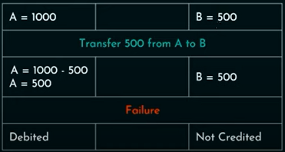
Atomicity Problems – Example
No partial execution of any transaction

Slide 42
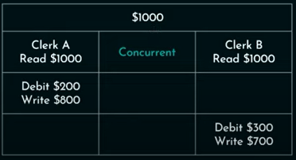
Concurrent-access anomalies- Example

Slide 43
DBMS | File System
DBMS is a collection of data. In DBMS, the user is not required to write the procedures. | File system is a collection of data. In this system, the user has to write the procedures for managing the database.
DBMS gives an abstract view of data that hides the details. | File system provides the detail of the data representation and storage of data.
DBMS provides a crash recovery mechanism, i.e., DBMS protects the user from the system failure. | File system doesn't have a crash mechanism, i.e., if the system crashes while entering some data, then the content of the file will lost.
DBMS provides a good protection mechanism. | It is very difficult to protect a file under the file system.
DBMS contains a wide variety of sophisticated techniques to store and retrieve the data. | File system can't efficiently store and retrieve the data.
DBMS takes care of Concurrent access of data using some form of locking. | In the File system, concurrent access has many problems like redirecting the file while other deleting some information or updating some information.

Slide 44
Advantages of Using a DBMS
Controlling Redundancy
Restricting Unauthorized Access
Providing Persistent Storage for Program Objects and Data Structures
Permitting Inferencing and Actions Using Rules
Providing Multiple User Interfaces
Representing Complex Relationships Among Data
Enforcing Integrity Constraints
Providing Backup and Recovery

Slide 45
Advantages of DBMS
Controls database redundancy: It can control data redundancy because it stores all the data in one single database file and that recorded data is placed in the database.
Data sharing: In DBMS, the authorized users of an organization can share the data among multiple users.
Easily Maintenance: It can be easily maintainable due to the centralized nature of the database system.
Reduce time: It reduces development time and maintenance need.
Backup: It provides backup and recovery subsystems which create automatic backup of data from hardware and software failures and restores the data if required.
multiple user interface: It provides different types of user interfaces like graphical user interfaces, application program interfaces

Slide 46
Disadvantages of DBMS
Cost of Hardware and Software: It requires a high speed of data processor and large memory size to run DBMS software.
Size: It occupies a large space of disks and large memory to run them efficiently.
Complexity: Database system creates additional complexity and requirements.
Higher impact of failure: Failure is highly impacted the database because in most of the organization, all the data stored in a single database and if the database is damaged due to electric failure or database corruption then the data may be lost forever.

Slide 47
Data model Schema and Instance
The data which is stored in the database at a particular moment of time is called an instance of the database.
The overall design of a database is called schema.
A database schema is the skeleton structure of the database. It represents the logical view of the entire database.
A schema contains schema objects like table, foreign key, primary key, views, columns, data types, stored procedure, etc.

Slide 48
A database schema can be represented by using the visual diagram. That diagram shows the database objects and relationship with each other.
A database schema is designed by the database designers to help programmers whose software will interact with the database. The process of database creation is called data modeling.
A schema diagram can display only some aspects of a schema like the name of record type, data type, and constraints. Other aspects can't be specified through the schema diagram. For example, the given figure neither show the data type of each data item nor the relationship among various files.

Slide 49
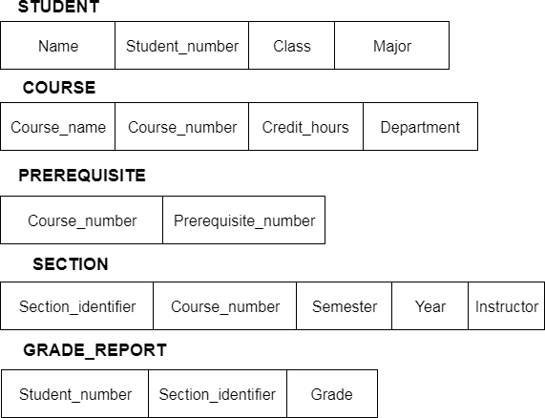

Slide 50
In the database, actual data changes quite frequently. For example, in the given figure, the database changes whenever we add a new grade or add a student. The data at a particular moment of time is called the instance of the database.

Slide 51
Three schema Architecture
The three-schema architecture divides the database into three-level used to create a separation between the physical database and the user application.
In simple terms, this architecture hides the details of physical storage from the user.
The database administrator (DBA) responsibility is to change the structure of database storage without affecting the user’s view. It deals with the data, the relationship between them and the different access methods implemented on the database.

Slide 52
This architecture contains three layers of database management system, which are as follows −
External level
Conceptual level
Internal level

Slide 53
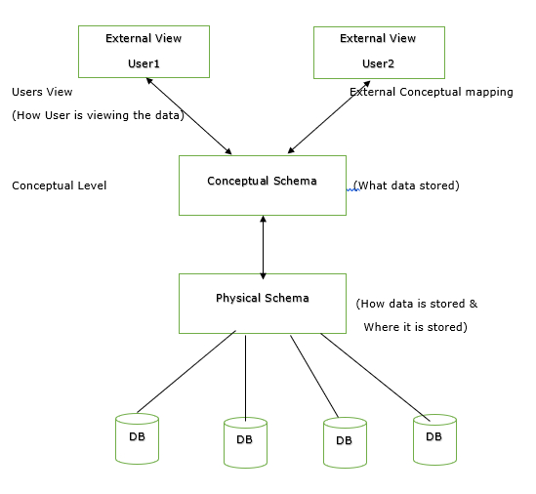
The three-schema architecture is as follows:
External Level
Internal Level

Slide 54
Internal or Physical level
The internal level has an internal schema which describes the physical storage structure of the database.
The internal schema is also known as a physical schema.
It uses the physical data model. It is used to define that how the data will be stored in a block.
The physical level is used to describe complex low-level data structures in detail.

Slide 55
Conceptual or Logical level
The conceptual schema describes the design of a database at the conceptual level. Conceptual level is also known as logical level.
The conceptual schema describes the structure of the whole database.
The conceptual level describes what data are to be stored in the database and also describes what relationship exists among those data.
In the conceptual level, internal details such as an implementation of the data structure are hidden.
Programmers and database administrators work at this level

Slide 56
External/ View level
This is the highest level of database abstraction. It includes a number of external schemas or user views.
This level provides different views of the same database for a specific user or a group of users.
An external view provides a powerful and flexible security mechanism by hiding the parts of the database from a particular user.

Slide 57
Data Independence
Data independence refers characteristic of being able to modify the schema at one level of the database system without altering the schema at the next higher level.
There are two types of data independence:
1. Logical Data Independence
Logical data independence refers characteristic of being able to change the conceptual schema without having to change the external schema.
Logical data independence is used to separate the external level from the conceptual view.
If we do any changes in the conceptual view of the data, then the user view of the data would not be affected.
Logical data independence occurs at the user interface level.

Slide 58
2. Physical Data Independence
Physical data independence can be defined as the capacity to change the internal schema without having to change the conceptual schema.
If we do any changes in the storage size of the database system server, then the Conceptual structure of the database will not be affected.
Physical data independence is used to separate conceptual levels from the internal levels.
Physical data independence occurs at the logical interface level.

Slide 59
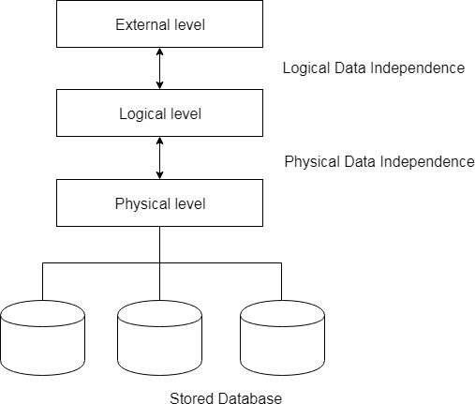
Fig: Data Independence

Slide 60
DBMS Architecture
It helps to design, develop, implement, and maintain the database management system.
A DBMS architecture allows dividing the database system into individual components that can be independently modified, changed, replaced, and altered.
It also helps to understand the components of a database.
A Database stores critical information and helps access data quickly and securely.
Therefore, selecting the correct Architecture of DBMS helps in easy and efficient data management.

Slide 61
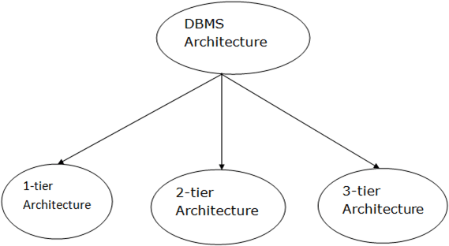
DBMS Architecture
The DBMS design depends upon its architecture.
The basic client/server architecture is used to deal with a large number of PCs, web servers, database servers and other components that are connected with networks.
The client/server architecture consists of many PCs and a workstation which are connected via the network.
DBMS architecture depends upon how users are connected to the database to get their request done.

Slide 62
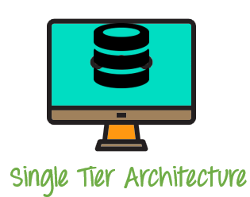
1-Tier Architecture
1 Tier Architecture in DBMS is the simplest architecture of Database in which the client, server, and Database all reside on the same machine.
A simple one tier architecture example would be anytime you install a Database in your system and access it to practice SQL queries.
Such architecture is rarely used in production.
In this architecture, the database is directly available to the user. It means the user can directly sit on the DBMS and uses it. Any changes done here will directly be done on the database itself. It doesn't provide a handy tool for end users. The 1-Tier architecture is used for development of the local application, where programmers can directly communicate with the database for the quick response.
In this architecture, the database is directly available to the user.
It means the user can directly sit on the DBMS and uses it. Any changes done here will directly be done on the database itself. It doesn't provide a handy tool for end users. The 1-Tier architecture is used for development of the local application, where programmers can directly communicate with the database for the quick response.

Slide 63
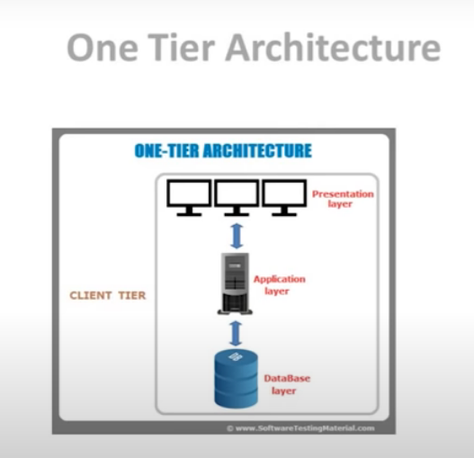
Example: Microsoft Excel, Word

Slide 64
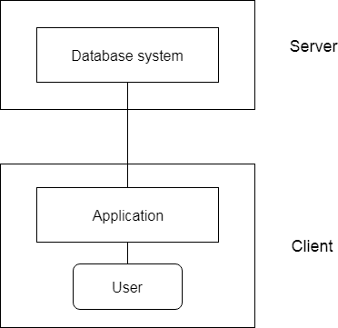
Two- Tier Architecture
The 2-Tier architecture is same as basic client-server.
Runs on application program that runs on client side.
Clients can directly interact with database.
In the two-tier architecture, applications on the client end can directly communicate with the database at the server side.
For this interaction (Interface), API's like: ODBC (Open Database Connectivity), JDBC are used.
The user interfaces and application programs are run on the client-side.
The server side is responsible to provide the functionalities like: query processing and transaction management.
To communicate with the DBMS, client-side application establishes a connection with the server side.

Slide 65
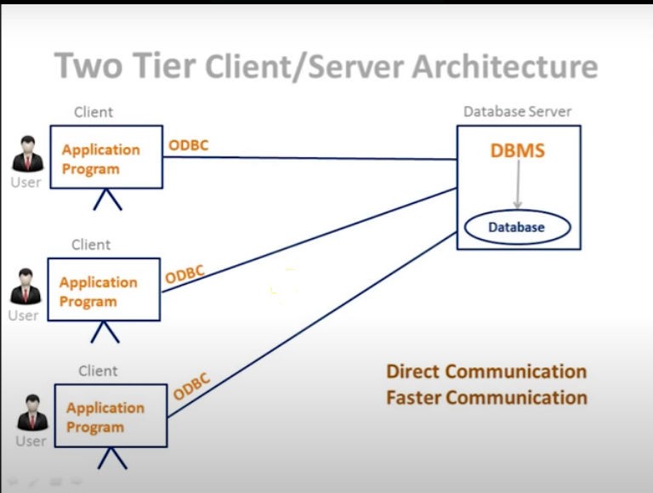

Slide 66
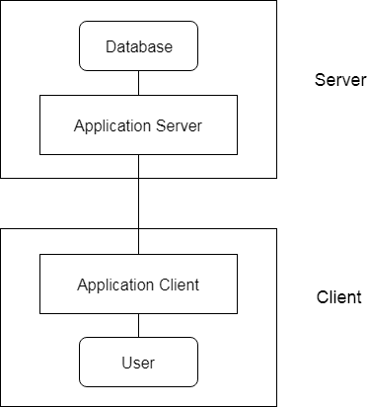
3-Tier Architecture
Internet based / website
The 3-Tier architecture contains another layer between the client and server.
In this architecture, client can't directly communicate with the server.
The application on the client-end interacts with an application server which further communicates with the database system.
End user has no idea about the existence of the database beyond the application server. The database also has no idea about any other user beyond the application.
The 3-Tier architecture is used in case of large web application.

Slide 67
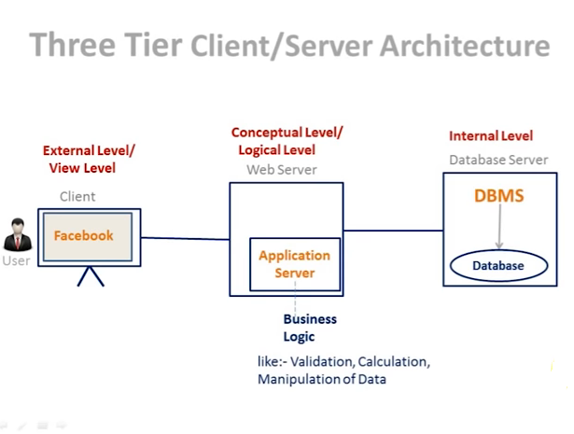

Slide 68
When Not to Use a DBMS
In spite of the advantages of using a DBMS, there are a few situations in which such a system may involve unnecessary overhead costs as that would not be incurred in traditional file processing. The overhead costs of using a DBMS are due to the following:
• High initial investment in hardware, software, and training.
• Generality that a DBMS provides for defining and processing data.
• Overhead for providing security, concurrency control, recovery, and integrity functions.
Additional problems may arise if the database designers and DBA do not properly design the database or if the database systems applications are not implemented properly. Hence, it may be more desirable to use regular files under the following circumstances:
• The database and applications are simple, well defined, and not expected to change.
• There are stringent real-time requirements for some programs that may not be met because of DBMS overhead.
• Multiple-user access to data is not required.

